Slide 1
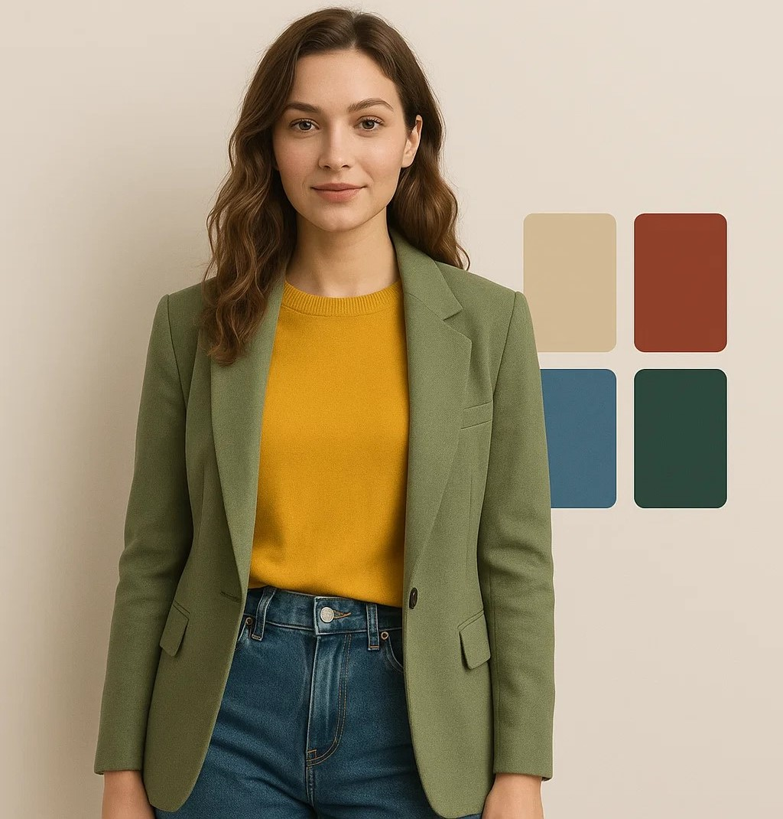
AI Stylist: Analyzing Outfit Color Harmony Using Deep Learning
MAKSYM VOLOSHYN
Introduction to Deep Learning
26-May-2025

Slide 2





Agenda
Intro
Problem Statement
Motivation
Benchmarking
Design
System Architecture Overview
DL Models Architecture
Color Theory Integration
Data Mining & Preparation
Training Config & Optimization
Results & Performance
YOLOv8 Detection Results
Color Extraction Accuracy
Learnings
Technical Challenges & Solutions
Course Concepts Applied Future Enhancements & Applications
Closing
Conclusions
Questions and Answers

Slide 3
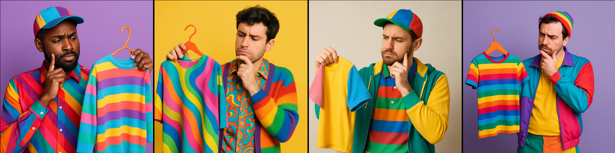
WHY?
1. Intro

Slide 4
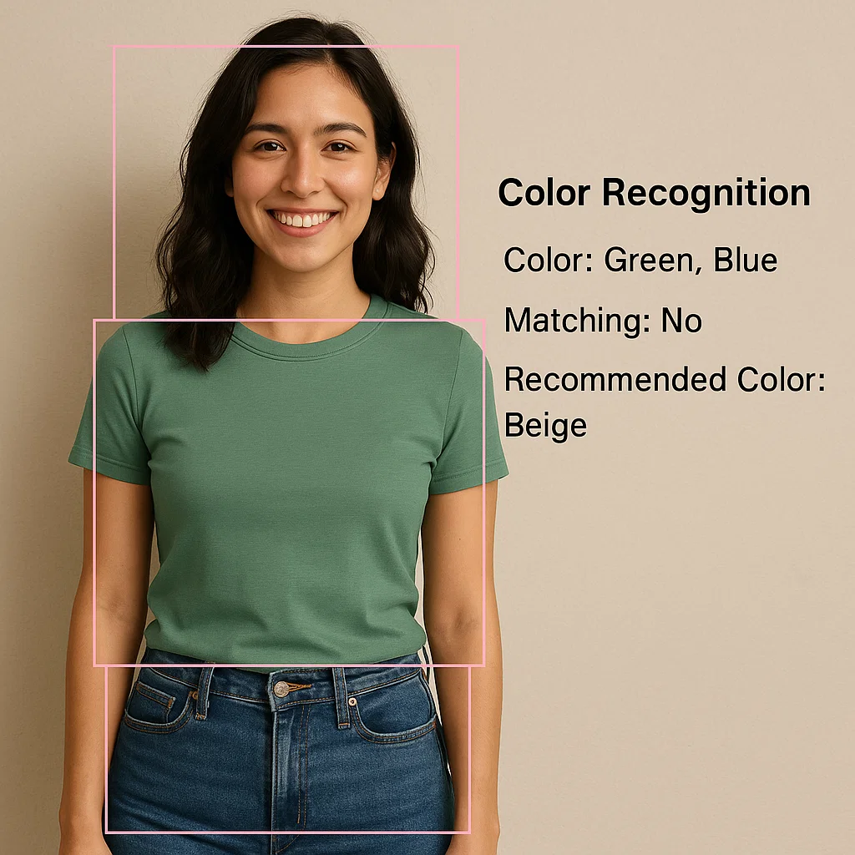
WHAT?
1. Intro

Slide 5
Motivation
Connection to Course
Real-world Application
Technical Challenge
Fashion Challenge
Real-Product Target
1. Intro
Notes:
Fashion Challenge: Manual color coordination is subjective and time-consuming
Real-world Application: E-commerce styling, personal fashion assistance, automated wardrobe analysis
Technical Challenge: Combining computer vision (object detection/segmentation) with color theory
Connection to Course: Practical application of supervised learning for real-world problem solving

Slide 6
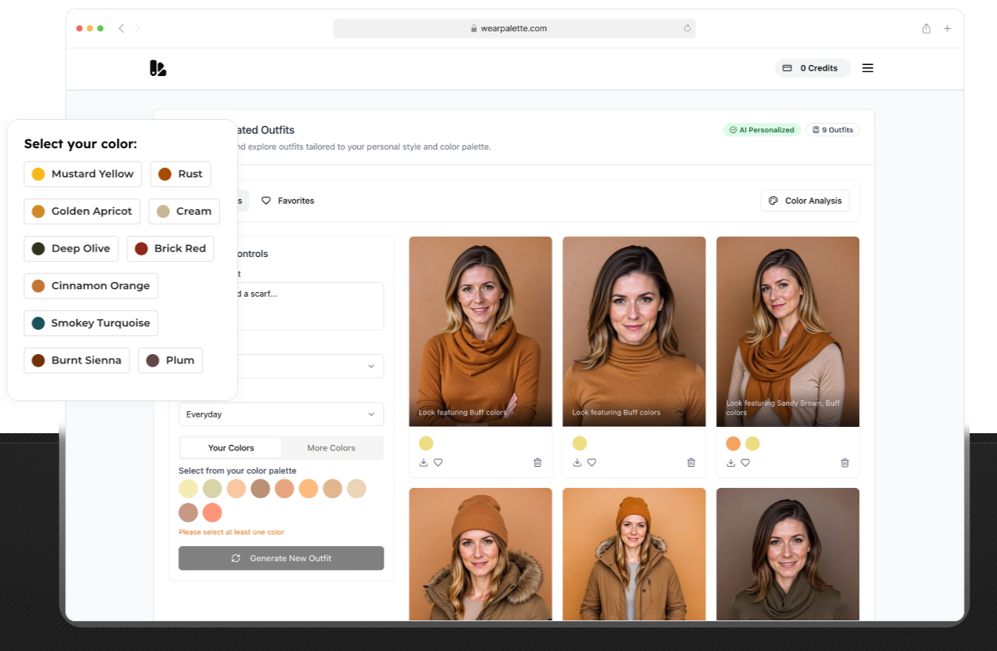
Benchmarking
WearPalette.com
1. Intro
Notes:
1. WearPalette.com (Commercial AI Color Analysis Platform)
What it does: Uses computer vision and machine learning to analyze a user’s natural coloring (skin, hair, eyes) and recommend personalized color palettes, including virtual try-on.
Key features:
High-precision, personalized color recommendations
Real-time analysis and visualization
Democratizes expert-level color analysis for consumers
Reference: [WearPalette.com, 2025]
1. Commercial platforms (like WearPalette) focus on user palette and virtual try-on.
2. Academic projects (DSCAS, Style-Me) integrate segmentation, color harmony, and retrieval.
3. Recent research uses deep learning for both segmentation and data-driven color matching.
4. My project advances the field by combining state-of-the-art YOLOv8 segmentation with color clustering and rule-based harmony assessment for fashion recommendations.

Slide 7
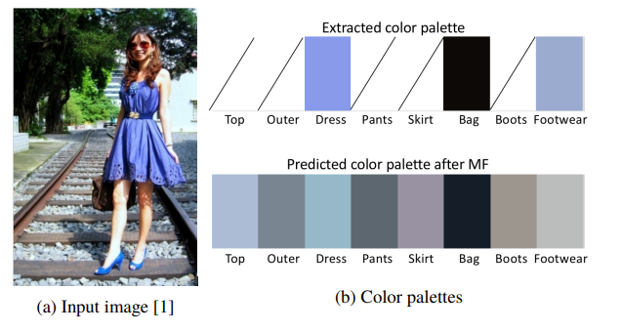
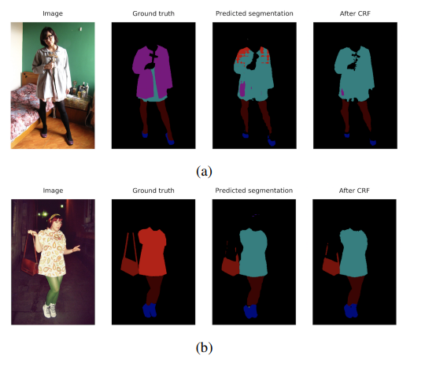
Benchmarking
WearPalette.com
"Towards color compatibility in fashion using machine learning", DIVA Portal, 2019
1. Intro
Notes:
2. "Towards Color Compatibility in Fashion Using Machine Learning" (Academic Paper)
What it does: Implements semantic segmentation on fashion images (Deeplab V2 on ModaNet), then uses collaborative filtering and matrix factorization to recommend compatible color combinations for outfits.
Key features:
State-of-the-art segmentation accuracy (mIoU 0.64)
Quantitative color compatibility learning
Recommends harmonious color combinations based on learned patterns
Reference: [DIVA Portal, 2019]
1. Commercial platforms (like WearPalette) focus on user palette and virtual try-on.
2. Academic projects (DSCAS, Style-Me) integrate segmentation, color harmony, and retrieval.
3. Recent research uses deep learning for both segmentation and data-driven color matching.
4. My project advances the field by combining state-of-the-art YOLOv8 segmentation with color clustering and rule-based harmony assessment for fashion recommendations.

Slide 8
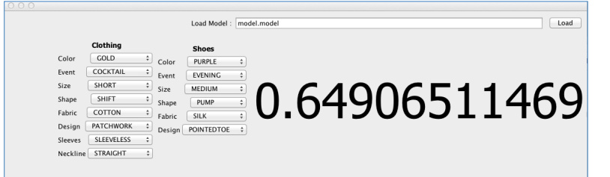
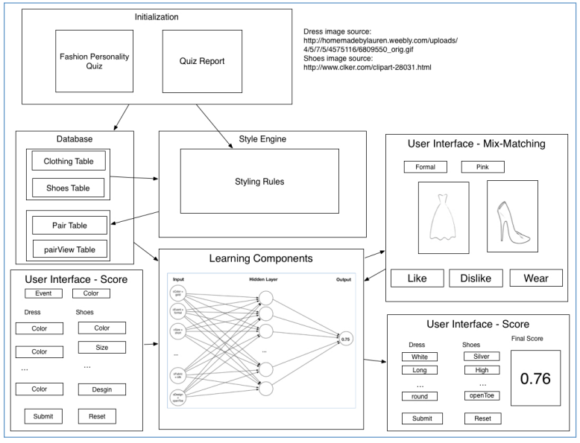
Benchmarking
WearPalette.com
"Towards color compatibility in fashion using machine learning", DIVA Portal, 2019
"MACHINE FASHION: An Artificial Intelligence Based Clothing Fashion Stylist", Haosha Wang, 2014
1. Intro
Notes:
3. Style-Me: An Artificial Intelligence Based Clothing Fashion Stylist (Academic Thesis)
What it does: Uses neural networks and rule-based systems to recommend fashion looks, including color harmony evaluation (Matsuda’s Color Coordination).
Key features:
Learns user preferences for personalized recommendations
Evaluates color harmony using established color theory
Adapts color suggestions to user style and trends
Reference: [Haosha Wang, University of Georgia, 2014]
1. Commercial platforms (like WearPalette) focus on user palette and virtual try-on.
2. Academic projects (DSCAS, Style-Me) integrate segmentation, color harmony, and retrieval.
3. Recent research uses deep learning for both segmentation and data-driven color matching.
4. My project advances the field by combining state-of-the-art YOLOv8 segmentation with color clustering and rule-based harmony assessment for fashion recommendations.

Slide 9
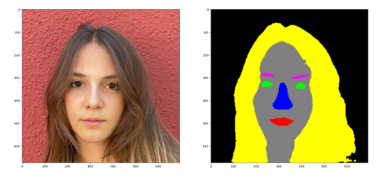
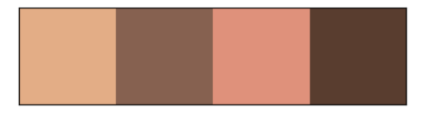
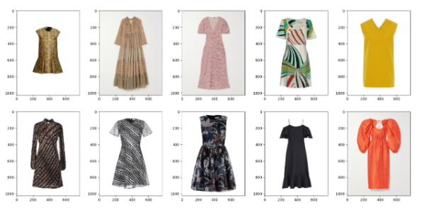
Benchmarking
WearPalette.com
"Towards color compatibility in fashion using machine learning", DIVA Portal, 2019
"MACHINE FASHION: An Artificial Intelligence Based Clothing Fashion Stylist", Haosha Wang, 2014
Deep Seasonal Color Analysis System (DSCAS), GitHub, 2022
1. Intro
Notes:
4. Deep Seasonal Color Analysis System (DSCAS, Academic Project)
What it does: Deep learning pipeline that assigns a color palette to a user based on color harmony principles, segments clothing, and retrieves compatible items from a database.
Key features:
Combines face and clothing segmentation
Uses palette classification and retrieval for fashion recommendation
Open-source, with full pipeline and report available
Reference: [GitHub: mrcmich/deep-seasonal-color-analysis-system, 2022]
1. Commercial platforms (like WearPalette) focus on user palette and virtual try-on.
2. Academic projects (DSCAS, Style-Me) integrate segmentation, color harmony, and retrieval.
3. Recent research uses deep learning for both segmentation and data-driven color matching.
4. My project advances the field by combining state-of-the-art YOLOv8 segmentation with color clustering and rule-based harmony assessment for fashion recommendations.

Slide 10

DESIGN
System Architecture
Key Decisions
Preparation

Slide 11
Learning Models Architecture: Learning Paradigms
Supervised Learning → Clothing Classification & Segmentation
Input: Fashion images with labeled clothing items
Output: Classified clothing items with precise segmentation masks
Goal: Learn function to map image regions → clothing categories
Unsupervised Learning → Color Clustering & Analysis
Input: Segmented clothing regions (no color labels)
Output: Dominant color clusters per clothing item
Goal: Discover underlying color structure in fashion items
2. Design
Notes:
Applied both supervised (YOLOv8 training) and unsupervised (K-means clustering) paradigms as covered in Lecture 01.
The core of workflow is an object detection and classification task, using YOLOv8 to both localize and categorize clothing items in images. The color extraction uses unsupervised learning, and the final steps are rule-based, leveraging domain knowledge rather than learning from data.
The task is an object detection and classification task, with additional steps involving color analysis and rule-based recommendation.
Object Detection: model (YOLOv8) is trained to detect clothing items in images by predicting their locations (bounding boxes) and segmenting precise pixels (masks). This is a classic object detection task, where the goal is to both localize and classify multiple objects (clothing items) within an image.
Classification: Each detected clothing item is classified into one of several categories (e.g., "skirt," "vest," "trousers"). This is a multi-class classification problem within the detected regions.
Attribute Extraction (Unsupervised/Clustering): The extraction of dominant colors using clustering algorithms like KMeans in HSV space is an unsupervised learning component, as you are grouping pixel colors without explicit labels.
Rule-Based Recommendation: Applying color theory and fashion rules to suggest color changes is a post-processing, rule-based system, not a typical machine learning task.

Slide 12
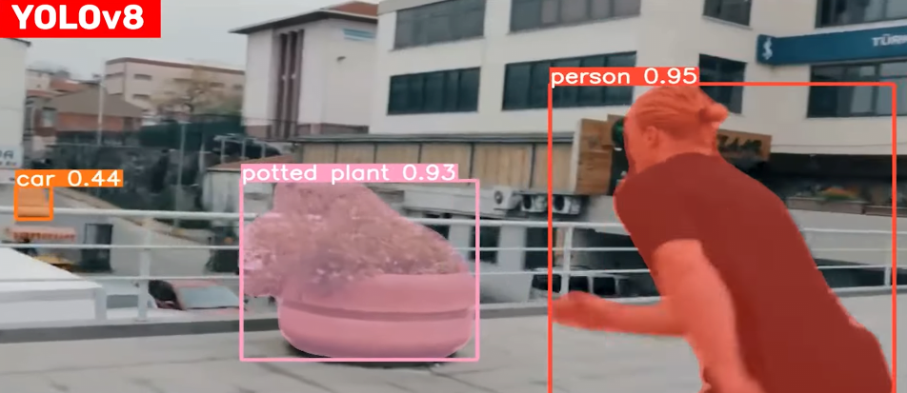
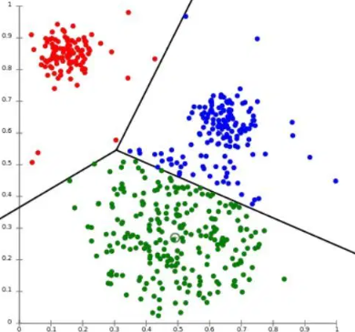
Learning Models Architecture: Learning Paradigms
Supervised Learning → Clothing Classification & Segmentation
Unsupervised Learning → Color Clustering & Analysis
YOLOv8
K-means
2. Design
Notes:
Applied both supervised (YOLOv8 training) and unsupervised (K-means clustering) paradigms as covered in Lecture 01
K-means is a clustering algorithm that groups data points into K clusters based on similarity. Here's how it works:
Algorithm Steps
1. Choose K (number of clusters): Decide how many groups you want to create in your data34.
2. Initialize centroids: Randomly place K centroids (cluster centers) in the data space35.
3. Assign data points: Each data point is assigned to the nearest centroid based on distance (typically Euclidean distance)36.
4. Recalculate centroids: Move each centroid to the center of its assigned points by calculating the average position of all points in that cluster35.
5. Repeat: Continue steps 3 and 4 until centroids stop moving significantly or assignments no longer change56.
Key Concept
The algorithm minimizes the distance between data points and their cluster centroids, ensuring that points within the same cluster are similar while points in different clusters are dissimilar6. Each centroid represents the arithmetic mean of its cluster, which is why it's called "K-means"6.
Convergence
The process continues iteratively until the algorithm converges - meaning the centroids stabilize and data point assignments no longer change, or a maximum number of iterations is reached56.
K-means is popular because it's simple, efficient with O(n) complexity, and works well for many real-world applications like customer segmentation and image processing

Slide 13
System Architecture Overview
1. Data mining and preparation
Downloaded DeepFashion2
Preprocess dataset, convert into YOLOv8 data structure
2. Train Clothing Recognition Model
Train YOLOv8 on recognizing cloths patterns (13)
3. Extract Dominant Colors for Each Item
Extract the region per mask
Detect clothing item (segmentation mask)
KMeans in HSV space clustering for dominant color
Hue to classify color
4. Apply Color Matching Rules
Use color theory to assess the harmony of detected colors
Define least matching clothes
5. Suggest Color Changes
Inform about least matching color and item
Suggest better matching color based
2. Design
Notes:
Data mining and preparation
Downloaded DeepFashion2 dataset
b. Preprocess dataset, i.e. convert into YOLOv8 model data structure
2. Train Clothing Recognition Model
Train YOLOv8 on recognizing cloths patterns (13 patterns, like "skirt", "vest", "trousers",)
b. Trained YOLOv8 model detects clothing item (segmentation mask ((1) precise pixels of the item, (2) class label (e.g. "skirt", "shirt"), (3) bounding box and confidence score)
3. Extract Dominant Colors for Each Item
For each mask, extract the region from the image.
b. Use a clustering algorithm (KMeans in HSV space) to find the dominant color(s) of the masked region.
c. We use hue to classify as warm/cool, and value/saturation for brightness and neutrality, to support applying color-matching rules.
4. Apply Color Matching Rules
Use color theory and fashion rules to assess the harmony of detected colors in the outfit
Define least matching clothes
5. Suggest Color Changes
a. Inform about least matching color and item
b. Suggest better matching color based on the rules in 4.

Slide 14
Model YOLOv8 Segmentation
Why YOLOv8 for Fashion Detection?
Real-time Performance: Single forward pass for detection + segmentation
Multi-task Learning: Simultaneous bounding box regression + mask prediction
Course Connection: Combines regression (bbox coordinates) + classification (clothing categories)
Model Outputs
Bounding Box Regression: (x, y, width, height) coordinates
Classification: 13 clothing categories with confidence scores
Segmentation Masks: Pixel-level clothing boundaries
Architecture: ResNet backbone + FPN + Detection/Segmentation heads (71M parameters)
2. Design
Notes:
(Reference: Lecture 03-Regression)
Default Activation: The primary activation function used in YOLOv8 is SiLU (Sigmoid Linear Unit), also known as the Swish activation. This is used throughout the backbone and head for most layers, providing a good balance between linearity and non-linearity, which helps improve performance and generalization in detection and segmentation tasks4.
Variants: Some YOLOv8 variants, like YOLOv8x-Mish, use the Mish activation function for potentially improved non-linearity and performance
YOLO architecture described:
ResNet Backbone: The first part of the network is a ResNet (Residual Network), such as ResNet-50 or ResNet-101. This section is responsible for extracting features from the input image. ResNet is well-known for its deep architecture and residual connections, which help the model learn complex patterns and avoid issues like vanishing gradients2.
FPN (Feature Pyramid Network): After the backbone, the extracted features are passed through an FPN. The FPN creates multi-scale feature maps by combining high-level semantic information with fine-grained details from earlier layers. This helps the model detect objects of various sizes more effectively by building a pyramid of feature maps at different resolutions235.
Detection/Segmentation Heads: These are the final layers that use the processed feature maps to predict object locations (bounding boxes), class labels, and, if applicable, segmentation masks. The detection head is for object detection, while the segmentation head is for pixel-level object masks2.
71M Parameters: This refers to the total number of learnable weights in the network. A higher number of parameters generally means a larger, more expressive model but also requires more memory and computational power.
In summary: This architecture uses a ResNet to extract features, FPN to enhance multi-scale detection, and specialized heads for detection and/or segmentation, resulting in a powerful model with around 71 million parameters235.

Slide 15
Alternatives? Mask R-CNN!
YOLOv8-seg outperforms Mask R-CNN and other two-stage detectors in both detection and segmentation precision.
YOLOv8-seg is better at generalizing to new, unseen patterns, while Mask R-CNN struggles with categories or patterns not present in the training set
YOLOv8 is a single-stage, end-to-end detector, enabling real-time segmentation and detection.
YOLOv8 supports easy fine-tuning on custom classes and segmentation tasks.
I tried R-CNN but my GPU couldn‘t work it out ☹
Model | mAP(seg) | Inference Speed | Generalization | Real-Time? | Customization
YOLOv8-seg | 69% | 7.8–10.9 ms | High | Yes | Easy
Mask R-CNN | 36.9% | 12.8–15.6 ms | Lower | No | Moderate
2. Design
Notes:
1. Accuracy and Generalization
YOLOv8-seg outperforms Mask R-CNN and other two-stage detectors in both detection and segmentation precision.
On a new test dataset, YOLOv8-seg achieved an mAP(seg) of 69%, compared to Mask R-CNN’s 36.91%3.
YOLOv8-seg is better at generalizing to new, unseen patterns, while Mask R-CNN struggles with categories or patterns not present in the training set3.
In agricultural and retail benchmarks, YOLOv8 consistently achieves higher precision and recall than Mask R-CNN, with faster inference times (e.g., 7.8–10.9 ms for YOLOv8 vs. 12.8–15.6 ms for Mask R-CNN)45.
2. Real-Time Performance
YOLOv8 is a single-stage, end-to-end detector, enabling real-time segmentation and detection.
This is crucial for applications like fashion retail, virtual try-on, and interactive color analysis, where latency matters5.
In retail analytics and surveillance, YOLOv8’s speed and efficiency make it the preferred choice for large-scale deployment25.
3. Flexibility and Modern Architecture
YOLOv8 supports easy fine-tuning on custom classes and segmentation tasks.
It integrates seamlessly with modern data pipelines and supports transfer learning, which accelerates convergence and improves performance on specialized datasets like DeepFashion22.
YOLOv8’s architecture is more adaptable to dynamic environments and diverse input data, as shown in both academic research and real-world deployments235
Mask R-CNN: Overview
Mask R-CNN (Mask Region-based Convolutional Neural Network) is a deep learning architecture designed for both object detection and instance segmentation. It extends Faster R-CNN by adding a parallel branch that generates pixel-level segmentation masks for each detected object. This enables Mask R-CNN to not only detect and classify objects, but also to outline their precise shapes at the pixel level—making it highly effective for tasks where detailed object boundaries are important268.
Key Features of Mask R-CNN
Instance Segmentation: Assigns a unique label and precise mask to each object instance, distinguishing overlapping and similarly shaped objects28.
Architecture: Built on top of Faster R-CNN, it includes:
A backbone network (often ResNet with Feature Pyramid Network) for feature extraction.
A Region Proposal Network (RPN) to suggest candidate object regions.
ROIAlign for accurate spatial alignment of features (improving over ROI Pooling).
A mask head branch to predict binary masks for each region of interest68.
Strengths: Excels at tasks requiring fine-grained segmentation, such as medical imaging, autonomous driving, and any scenario where object boundaries matter268.
Limitations: Computationally intensive, slower inference, and more complex to implement and train compared to single-stage detectors36.
YOLOv8: Overview
YOLOv8 is the latest iteration of the "You Only Look Once" family, known for real-time object detection. While the original YOLO models focused on fast, accurate bounding box detection, YOLOv8 (and its segmentation variant, YOLOv8-seg) can also perform instance segmentation, making it a direct competitor to Mask R-CNN for some tasks34.
Key Features of YOLOv8
One-Stage Detector: Processes the entire image in a single pass, predicting bounding boxes, class labels, and (in the segmentation variant) masks directly34.
Speed: Designed for high efficiency and real-time applications, with significantly faster inference and smaller model size than Mask R-CNN510.
Accuracy: Achieves high mean average precision (mAP) and regression scores, especially in object detection tasks, and performs well even on new, unseen data due to its holistic, end-to-end approach459.
Limitations: While segmentation quality is strong, Mask R-CNN may still outperform YOLOv8 in scenarios requiring the most detailed, pixel-perfect segmentation or in highly complex scenes34.
Key Differences: Mask R-CNN vs YOLOv8
Feature/AspectMask R-CNNYOLOv8ArchitectureTwo-stage: region proposal + detection + maskOne-stage: direct detection and segmentationSegmentationPixel-level, high-precision instance segmentationGood segmentation, but may be less detailed in complex scenesSpeedSlower, higher computational loadMuch faster, real-time capableModel SizeLarger (hundreds of MB)Smaller (tens of MB)Accuracy (mAP)High, especially for segmentation tasksOften higher for detection, competitive or better for segmentation in many benchmarks345910GeneralizationMay struggle with unseen patterns or categoriesStrong generalization to new data4Use Case PreferenceBest for tasks needing precise segmentationBest for real-time applications, rapid deployment, and efficient inference3510
Performance Comparison
Precision and Recall: YOLOv8 often achieves higher precision and recall than Mask R-CNN across diverse datasets, especially when real-time inference is required59.
Segmentation Quality: Mask R-CNN can provide more detailed masks and higher recall in complex scenes, but YOLOv8-seg is competitive and sometimes superior in precision and generalization45.
Speed and Efficiency: YOLOv8 is significantly faster and more resource-efficient, making it suitable for embedded and real-time systems510.
Model Size: YOLOv8 models are much smaller, enabling easier deployment10.
Summary
Mask R-CNN is the go-to model for high-precision, pixel-level instance segmentation, especially where object boundaries and segmentation quality are critical. It is, however, slower and more resource-intensive268.
YOLOv8 excels in real-time detection and segmentation, offering faster inference, smaller model size, and strong performance across both detection and segmentation tasks. It is generally preferred for applications where speed and efficiency are paramount, and segmentation detail is "good enough"3510.
In short: Choose Mask R-CNN for the highest-quality segmentation in research or applications where precision matters most. Choose YOLOv8 for real-time, efficient deployment with robust performance across detection and segmentation tasks

Slide 16
Model K-means for Color Detection
Why K-means?
K-Means is a fast, efficient, and well-understood algorithm for clustering color pixels.
It converges quickly and is easy to implement in standard libraries (scikit-learn, OpenCV)
K-Means directly produces a set of dominant colors (cluster centroids) - main hues in a clothing item
Method | Speed | Interpretability | Accuracy (for color) | Complexity | Use in Literature
K-Means | Fast | High | High (for color) | Low | Standard
FCM | Slow | Medium | Higher (complex img) | Medium | Sometimes
GMM | Slow | Medium | High (non-spherical) | High | Rare
SOM | Very Slow | Medium | High | High | Rare
2. Design
Notes:
Why K-Means for Color Extraction and Not Other Clustering Methods?
1. Simplicity and Speed
K-Means is a fast, efficient, and well-understood algorithm for clustering color pixels.
It converges quickly and is easy to implement in standard libraries (scikit-learn, OpenCV)1
For image segmentation and color palette extraction, K-Means is a standard baseline due to its low computational cosT
2. Effective Palette Generation
K-Means directly produces a set of dominant colors (cluster centroids) that represent the main hues in a clothing item.
This is ideal for generating color palettes, quantifying color proportions, and supporting downstream color harmony analysis
3. Benchmarking Against Alternatives
Fuzzy C-Means (FCM): Allows soft assignment of pixels to clusters, which can improve results for complex images, but is much slower and more sensitive to initialization.
Gaussian Mixture Models (GMM): More flexible for non-spherical clusters, but slower and often unnecessary for color extraction, where clusters are usually compact and well-separated
Self-Organizing Maps (SOM): Can produce high-quality color segmentation but requires much longer training and is less interpretable
K-Means++: An improved initialization variant, used in some academic works for even better convergence

Slide 17
Model K-means for Color Detection
Unsupervised Learning Applications
No labeled color data → Discover natural color groupings
Clustering objective: Group similar colors without supervision
Feature extraction: Reduce thousands of pixels → 5 dominant colors
# PSEUDOCODE
# Applied K-means in RGB color space for better perceptual clustering
masked_pixels = image[segmentation_mask > 0]
rgb_pixels = cv2.cvtColor(masked_pixels, cv2.COLOR_RGB)
kmeans = KMeans(n_clusters=5, random_state=42)
dominant_colors = kmeans.fit(hsv_pixels).cluster_centers_
2. Design
Notes:
Why K-Means for Color Extraction and Not Other Clustering Methods?
1. Simplicity and Speed
K-Means is a fast, efficient, and well-understood algorithm for clustering color pixels.
It converges quickly and is easy to implement in standard libraries (scikit-learn, OpenCV)1
For image segmentation and color palette extraction, K-Means is a standard baseline due to its low computational cosT
2. Effective Palette Generation
K-Means directly produces a set of dominant colors (cluster centroids) that represent the main hues in a clothing item.
This is ideal for generating color palettes, quantifying color proportions, and supporting downstream color harmony analysis
3. Benchmarking Against Alternatives
Fuzzy C-Means (FCM): Allows soft assignment of pixels to clusters, which can improve results for complex images, but is much slower and more sensitive to initialization.
Gaussian Mixture Models (GMM): More flexible for non-spherical clusters, but slower and often unnecessary for color extraction, where clusters are usually compact and well-separated
Self-Organizing Maps (SOM): Can produce high-quality color segmentation but requires much longer training and is less interpretable
K-Means++: An improved initialization variant, used in some academic works for even better convergence

Slide 18
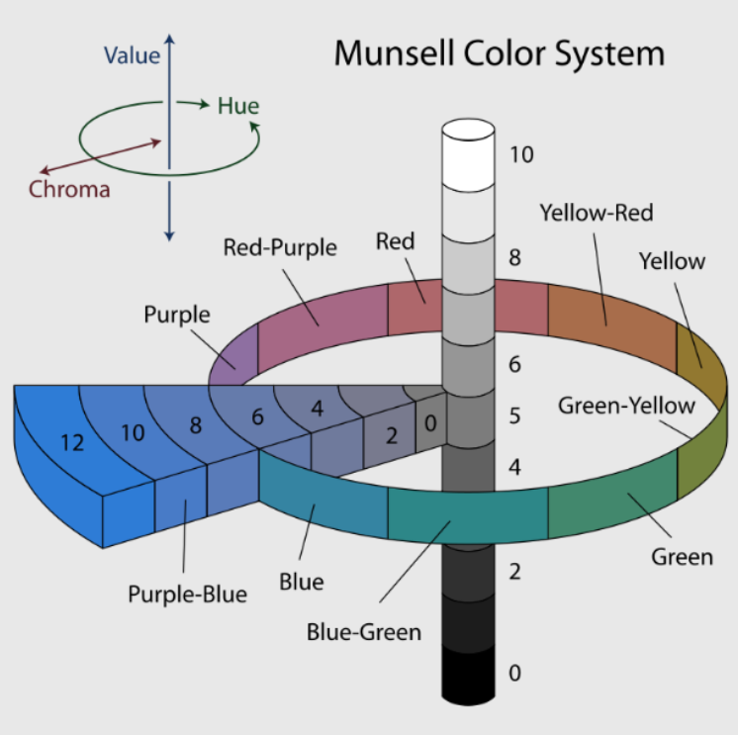
Color Theory Integration
HSV Color Space Analysis
Hue (H): Determines warm vs. cool classification
Warm: 0-60° (reds, oranges, yellows)
Cool: 180-300° (blues, greens, purples)
Saturation (S): Color intensity and vibrancy
Value (V): Brightness level
Fashion Color Harmony Rules
Complementary Colors: Opposite on color wheel (high contrast)
Analogous Colors: Adjacent colors (harmonious)
Triadic Colors: Equally spaced (balanced vibrancy)
Rule of Three: Maximum 3 colors per outfit
2. Design
Notes:
Why K-Means for Color Extraction and Not Other Clustering Methods?
1. Simplicity and Speed
K-Means is a fast, efficient, and well-understood algorithm for clustering color pixels.
It converges quickly and is easy to implement in standard libraries (scikit-learn, OpenCV)1
For image segmentation and color palette extraction, K-Means is a standard baseline due to its low computational cosT
2. Effective Palette Generation
K-Means directly produces a set of dominant colors (cluster centroids) that represent the main hues in a clothing item.
This is ideal for generating color palettes, quantifying color proportions, and supporting downstream color harmony analysis
3. Benchmarking Against Alternatives
Fuzzy C-Means (FCM): Allows soft assignment of pixels to clusters, which can improve results for complex images, but is much slower and more sensitive to initialization.
Gaussian Mixture Models (GMM): More flexible for non-spherical clusters, but slower and often unnecessary for color extraction, where clusters are usually compact and well-separated
Self-Organizing Maps (SOM): Can produce high-quality color segmentation but requires much longer training and is less interpretable
K-Means++: An improved initialization variant, used in some academic works for even better convergence

Slide 19
Color Matching Algorithm
Clash Detection Logic
Temperature Mixing: Avoid excessive warm + cool combinations
Saturation Balance: Prevent overwhelming bright colors
Value Contrast: Ensure sufficient light/dark balance
# PSEUDOCODE
def assess_color_harmony(detected_colors):
# 1. Classify warm/cool/neutral
color_temperatures = classify_temperature(colors)
# 2. Check color theory rules
harmony_score = calculate_harmony(colors)
# 3. Identify clashing items
clashing_items = find_clashes(color_temperatures, harmony_score)
return harmony_assessment, recommendations
2. Design
Notes:
1. Ultra-Strict Scoring System:
Single neutral items: 35% max (was 100%)
All neutral outfits: -50% penalty (massive)
All dark outfits: -30% penalty
All washed out: -30% penalty
No actual colors: -40% penalty
2. New Issue Categories:
completely_monotone_boring
mostly_neutral_lacks_interest
all_dark_depressing
all_washed_out
no_actual_colors
no_focal_point
outfit_needs_color_interest
3. Score Compression:
Scores above 80% compressed to max 70%
Scores above 60% compressed to 40-55%
Most outfits will score 20-50%
4. Realistic Expectations:
All gray/black outfits: 25-35%
Navy + white: 60-65%
Mixed warm/cool: 20-35%
Perfect classic combinations: 65-70% max

Slide 20
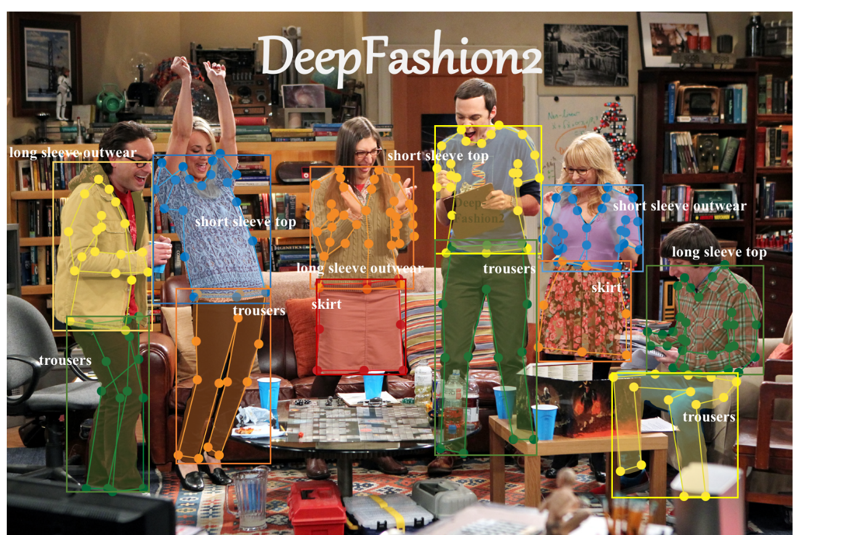
Data Mining & Prep
Dataset: DeepFashion2
Size: 491K diverse images, 801K clothing items
It is split into a training set (391K images), a validation set (34k images), and a test set (67k images).
Categories: 13 clothing types (shirt, trousers, skirt, vest, etc.)
Annotations: Bounding boxes, segment. masks, landmarks
2. Design

Slide 21
Data Mining & Prep
Why DeepFashion2?
1. Scale and Diversity
2. Rich, Detailed Annotations
3. Benchmarking and Community Adoption
4. Real-World Relevance
Challenge: Convert DeepFashion2 format → YOLOv8 training format
Data Preprocessing Pipeline:
DeepFashion2 JSON → YOLO Segmentation Format
├── Extract polygon coordinates from 'item1','item2'... keys
├── Normalize coordinates to [0,1] range
├── Convert category_id (1-13) → class_id (0-12)
└── Generate .txt label files for YOLOv8 training
2. Design
Notes:
1. Scale and Diversity
Largest public fashion dataset: Over 491,000 images and 801,000 clothing items, covering both commercial shopping images and real-world consumer photos
Rich variety: Includes 13 popular clothing categories (e.g., skirt, vest, trousers, etc.) and a wide range of styles, poses, occlusions, scales, and viewpoints
Multiple items per image: Unlike older datasets (e.g., DeepFashion1, FashionAI), DeepFashion2 images can contain several clothing items, reflecting real-world complexity
2. Rich, Detailed Annotations
Comprehensive labels: Each clothing item is annotated with bounding boxes, per-pixel segmentation masks, dense landmarks (for pose/shape), category, style, and more
Supports multiple tasks: Enables not just detection and classification, but also fine-grained segmentation, pose estimation, and cross-domain retrieval.
Commercial-consumer pairs: Contains 873,000 pairs linking store and user-worn versions of the same garment, supporting research in retrieval and style transfer.
3. Benchmarking and Community Adoption
Standard benchmark: Used in major computer vision challenges (e.g., CVPR DeepFashion2 Challenge) and widely adopted in both academia and industry.
Strong baselines: Provides reference results for leading models (e.g., YOLO, Mask R-CNN, Match R-CNN), making it ideal for fair comparison and reproducibility.
Versatility: Suitable for detection, segmentation, landmark estimation, and retrieval, making it the go-to dataset for comprehensive fashion AI research.
4. Real-World Relevance
E-commerce and retail: Data is collected from both online stores and real users, ensuring the model learns from diverse, realistic scenarios.
Rich variation: Includes challenging cases (e.g., occlusion, zoom-in, different viewpoints) critical for robust, deployable models.

Slide 22
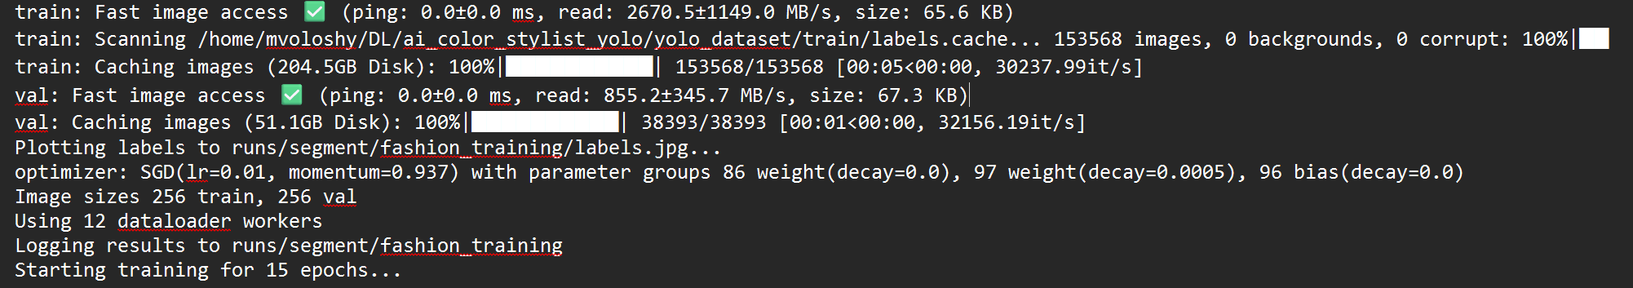
Data Mining & Prep
Challenge: too many images, how to speed up processing images
Cache disk (or --cache disk) is a setting of YOLOv8 to speed up data loading by storing preprocessed images and labels on the local disk, rather than reading and processing them from scratch every epoch.
Why did we use cache disk?
Faster Training (2x)
Saves RAM
Stability
The dataset expanded from 11G to 250G!
2. Design
Notes:
1. Scale and Diversity
Largest public fashion dataset: Over 491,000 images and 801,000 clothing items, covering both commercial shopping images and real-world consumer photos
Rich variety: Includes 13 popular clothing categories (e.g., skirt, vest, trousers, etc.) and a wide range of styles, poses, occlusions, scales, and viewpoints
Multiple items per image: Unlike older datasets (e.g., DeepFashion1, FashionAI), DeepFashion2 images can contain several clothing items, reflecting real-world complexity
2. Rich, Detailed Annotations
Comprehensive labels: Each clothing item is annotated with bounding boxes, per-pixel segmentation masks, dense landmarks (for pose/shape), category, style, and more
Supports multiple tasks: Enables not just detection and classification, but also fine-grained segmentation, pose estimation, and cross-domain retrieval.
Commercial-consumer pairs: Contains 873,000 pairs linking store and user-worn versions of the same garment, supporting research in retrieval and style transfer.
3. Benchmarking and Community Adoption
Standard benchmark: Used in major computer vision challenges (e.g., CVPR DeepFashion2 Challenge) and widely adopted in both academia and industry.
Strong baselines: Provides reference results for leading models (e.g., YOLO, Mask R-CNN, Match R-CNN), making it ideal for fair comparison and reproducibility.
Versatility: Suitable for detection, segmentation, landmark estimation, and retrieval, making it the go-to dataset for comprehensive fashion AI research.
4. Real-World Relevance
E-commerce and retail: Data is collected from both online stores and real users, ensuring the model learns from diverse, realistic scenarios.
Rich variation: Includes challenging cases (e.g., occlusion, zoom-in, different viewpoints) critical for robust, deployable models.

Slide 23
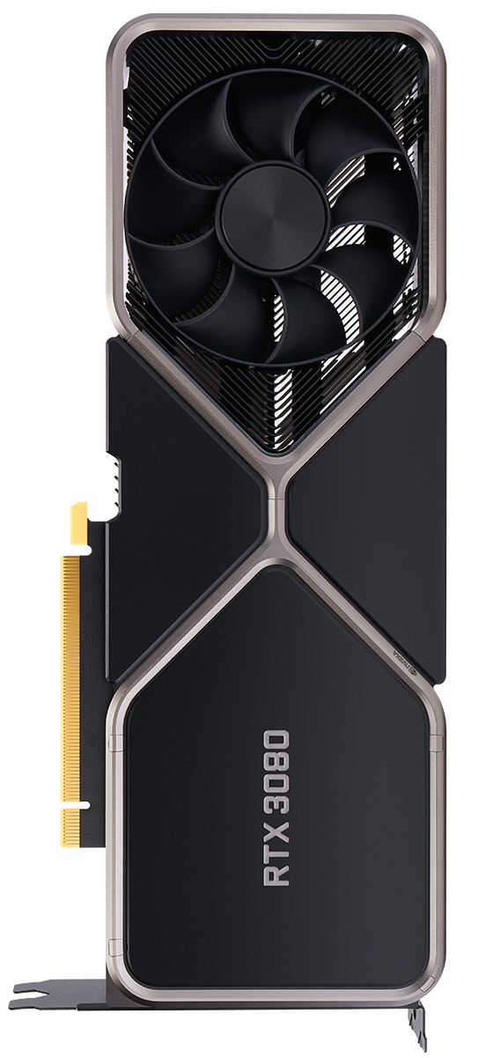
Training Configuration & Optimization
Hardware Optimization for RTX 3080
Model Size: Medium (balance between speed/accuracy)
Batch Size: 64 images (maximizing GPU utilization (~70% achieved)
Image Resolution: 256x256 (speed vs. detail tradeoff)
Training Time: ~13 hours for 15 epochs
Extra: Cash Disk, early stop (patience: 5), workers: 12
Training Hyperparameters
Dataset Split: 80% train / 20% validation
Optimizer: SGD with momentum (0.937)
Learning Rate: 0.01 with step decay
Augmentation: Enabled for robustness
2. Design
Notes:
1. Dataset Split: 80% train / 20% validation
What it is: The ratio of data used for training (learning patterns) vs. validation (checking model performance on unseen data).
Why it matters: Ensures the model is evaluated on data it hasn’t seen, helping to detect overfitting and select the best model.
2. Optimizer: SGD with momentum (0.937)
What it is: The optimizer updates the model’s weights to minimize loss.
SGD (Stochastic Gradient Descent): Updates weights using small random batches.
Momentum: Helps accelerate SGD in the right direction and dampens oscillations, controlled by the momentum value (here, 0.937).
Why it matters: Using momentum helps the model converge faster and avoid getting stuck in local minima
3. Learning Rate: 0.01 with step decay
What it is: Controls how much the model weights are updated during training.
0.01: The initial step size for each update.
Step decay: The learning rate is reduced by a set factor after a certain number of epochs to allow finer adjustments as training progresses4.
Why it matters: Too high = unstable training, too low = slow learning. Decay helps the model settle into a good solution.
4. Augmentation: Enabled for robustness
What it is: Artificially increases dataset size and diversity by applying random transformations (flips, rotations, color changes, etc.) to training images.
Why it matters: Prevents overfitting and helps the model generalize to new, unseen data.
Hyperparameter Typical Value Why This Value?
Optimizer SGD Efficient for large data, good generalization
Momentum 0.937 Fast, stable convergence (YOLO default)
Learning Rate 0.01 Fast learning, avoids divergence
Step Decay Yes Fine-tunes model as training progresses
Term What It Does Why It Matters
SGD Updates weights using small random batches Fast, efficient, generalizes well
Learning Rate (0.01) Controls update step size Balances speed and stability
Step Decay Reduces learning rate at set intervals Large steps early, fine-tuning later
SGD (Stochastic Gradient Descent): What It Is and Why These Values?
SGD is an optimization algorithm used to train deep learning models. Instead of computing the gradient of the loss on the entire dataset (which is slow), SGD updates the model weights using only a small subset (a mini-batch) of the data at each step. This makes training much faster and more scalable for large datasets527.
Momentum (e.g., 0.937)
What it does: Momentum helps accelerate SGD in the direction of consistent gradients and dampens oscillations. It does this by adding a fraction of the previous update to the current update.
Why 0.937? This value is commonly used in modern YOLO and other deep learning models68. It provides a good balance between stability and speed. Higher momentum (like 0.99) makes updates smoother but can overshoot; lower (like 0.8) may not smooth enough. Empirical studies (including in YOLO and other vision models) have shown 0.937 to be a robust default for fast convergence and stable training6834.
Why Use SGD?
Efficiency: Handles large datasets efficiently, especially for computer vision tasks527.
Generalization: The noise from using mini-batches can help the model escape poor local minima and generalize better57.
Widely Supported: Used in most deep learning frameworks and is the default for many vision models, including YOLO56.
Learning Rate: 0.01 with Step Decay
Learning Rate (0.01): This controls how big a step the optimizer takes in the direction of the gradient at each update. A value of 0.01 is a common starting point for SGD in deep learning, especially for models like YOLO68.
Too high: The model may diverge or oscillate.
Too low: Training is slow and may get stuck.
Step Decay: This means the learning rate is reduced by a set factor (e.g., 10x) at specific epochs (steps) during training. This allows the model to make large updates early (to learn quickly) and then smaller, more precise updates later (to fine-tune and converge).
Why use it? It helps the model settle into a minimum and improves final accuracy.
Empirical Reasoning: These values (0.01 for learning rate and 0.937 for momentum) are well-studied defaults for YOLO and similar large-scale vision models, balancing speed, stability, and generalization

Slide 24

Training
Results
Performance

Slide 25
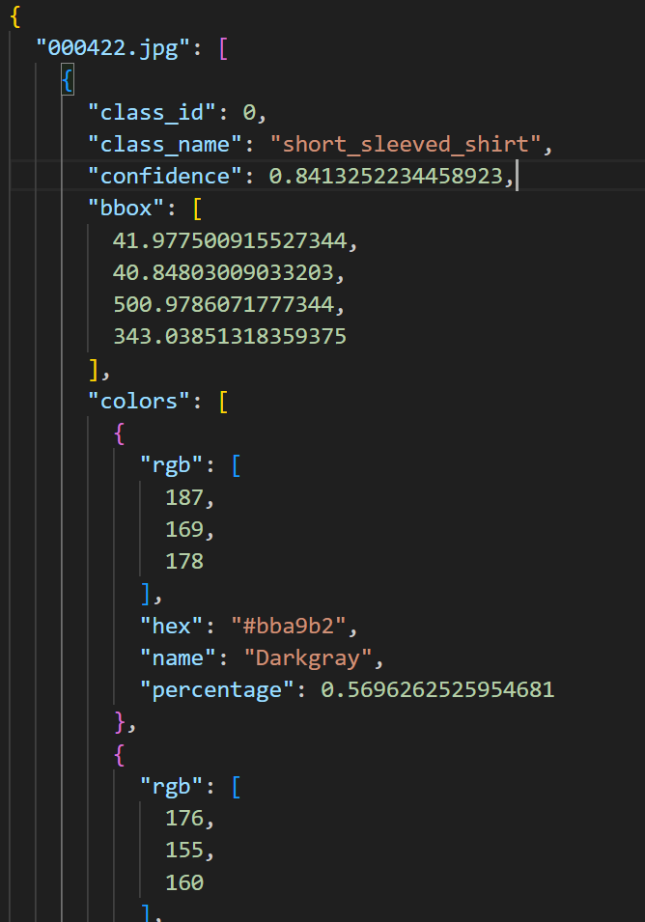
Color extraction model output
JSON file including Per-Item Detection Details:
1. Class Identification: short_sleeved_shirt, long_sleeved_shirt, etc.
Confidence Scores: Ranging from 0.58 to 0.92
Bounding Boxes: Pixel coordinates defining item location [x_min, y_min, x_max, y_max]
2. Color Analysis:
Dominant Color: Primary color with highest percentage
Full Color Breakdown: Up to 5 colors per item
Includes RGB values, hex codes, color names, and coverage percentages
3. Results & Performance

Slide 26
DL Model Training - Performance
3. Results & Performance
Notes:
Training Metrics Section
HeaderMeaningImpactImprovement Tips
Epoch
Current training epoch (iteration over full dataset).Determines model's training progress; too few = underfit, too many = overfit.
Use early stopping or monitor validation loss/metrics to find the optimal number of epochs
.GPU_mem
Amount of GPU memory used (e.g. 4.89G).Indicates computational load.
Not a performance metric, but can limit model size or batch size.Optimize data loading, batch size, and model architecture to fit available memory.
box_loss
Loss related to bounding box regression (coordinates).
Directly affects how accurately boxes match object locations. Lower is better.
Improve with better anchors, more diverse data, or increasing model capacity.
seg_loss
Loss related to segmentation masks (per-pixel classification).Affects how well object shapes are captured. Critical for instance segmentation.
Use high-resolution inputs and augmentations like CutMix, Mosaic, or MixUp.
cls_loss
Classification loss for detected objects (label prediction).Impacts model's ability to distinguish between object classes.
Improve label quality, class balance, and consider focal loss if imbalance exists.
dfl_loss
Distribution Focal Loss (bounding box quality).Enhances bounding box precision (especially edge alignment).Usually improves with more epochs, better anchors, or using richer input features (e.g., larger image size).
Instances
Number of instances (objects) seen in current epoch.
Just informational; higher can mean richer training batches.
Use stratified sampling to ensure class balance and meaningful variation across batches.
Size
Input image resolution during training (e.g., 256).Affects detail captured in objects. Larger size = better quality but more compute.
Increase gradually if training time and memory permit (e.g., step from 256 → 512). Can significantly boost detection and segmentation accuracy.
Detection (Box) Metrics
Header Meaning Impact Improvement Tips
Box(P)
Precision of bounding box predictions (TP / (TP + FP)).
Higher = fewer false positives.
Tweak confidence threshold, use better post-processing (e.g., NMS), reduce label noise.
Box(R)
Recall of box predictions (TP / (TP + FN)).
Higher = fewer missed detections.
Increase object coverage with augmentations, reduce occlusion, improve class balance.
mAP50
Mean Average Precision at IoU=0.5.
General indicator of detection performance.
Widely used metric. Boost with improved training data and longer training.
mAP50-95
mAP averaged over IoU thresholds from 0.5 to 0.95.
Stricter, more precise metric than mAP50.Improves with better localization and generalization.
Prioritize for production-quality models.

Slide 27
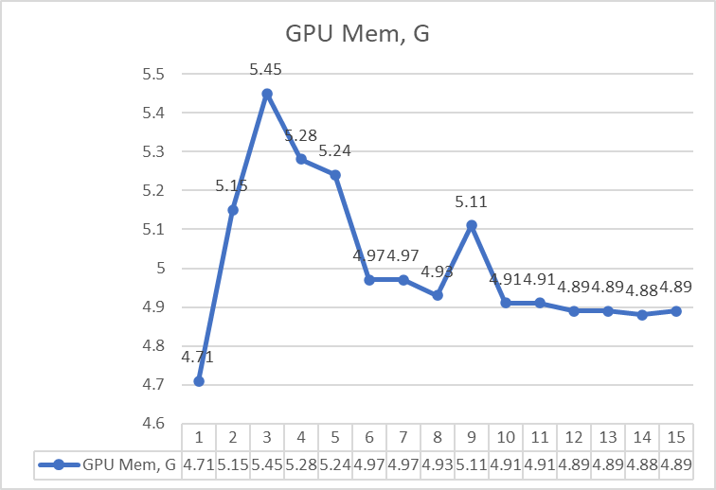
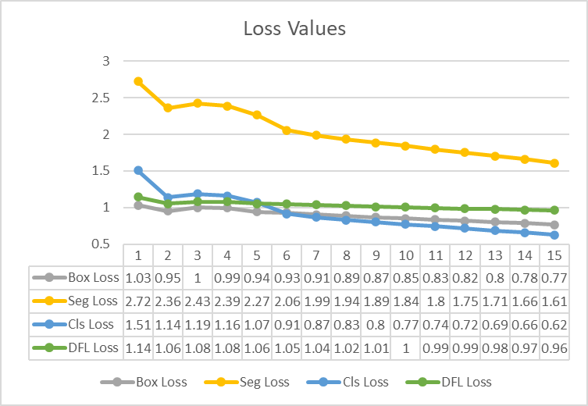
DL Model – Training Metrics
3. Results & Performance
Notes:
Training Metrics Section
HeaderMeaningImpactImprovement Tips
Epoch
Current training epoch (iteration over full dataset).Determines model's training progress; too few = underfit, too many = overfit.
Use early stopping or monitor validation loss/metrics to find the optimal number of epochs
.GPU_mem
Amount of GPU memory used (e.g. 4.89G).Indicates computational load.
Not a performance metric, but can limit model size or batch size.Optimize data loading, batch size, and model architecture to fit available memory.
box_loss
Loss related to bounding box regression (coordinates).
Directly affects how accurately boxes match object locations. Lower is better.
Improve with better anchors, more diverse data, or increasing model capacity.
seg_loss
Loss related to segmentation masks (per-pixel classification).Affects how well object shapes are captured. Critical for instance segmentation.
Use high-resolution inputs and augmentations like CutMix, Mosaic, or MixUp.
cls_loss
Classification loss for detected objects (label prediction).Impacts model's ability to distinguish between object classes.
Improve label quality, class balance, and consider focal loss if imbalance exists.
dfl_loss
Distribution Focal Loss (bounding box quality).Enhances bounding box precision (especially edge alignment).Usually improves with more epochs, better anchors, or using richer input features (e.g., larger image size).
Instances
Number of instances (objects) seen in current epoch.
Just informational; higher can mean richer training batches.
Use stratified sampling to ensure class balance and meaningful variation across batches.
Size
Input image resolution during training (e.g., 256).Affects detail captured in objects. Larger size = better quality but more compute.
Increase gradually if training time and memory permit (e.g., step from 256 → 512). Can significantly boost detection and segmentation accuracy.

Slide 28
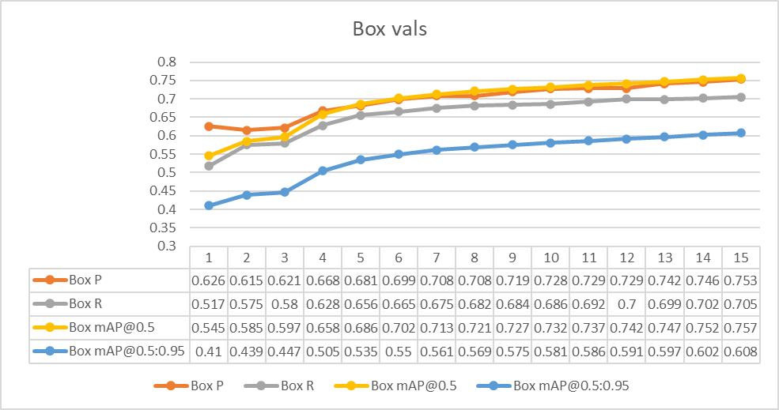
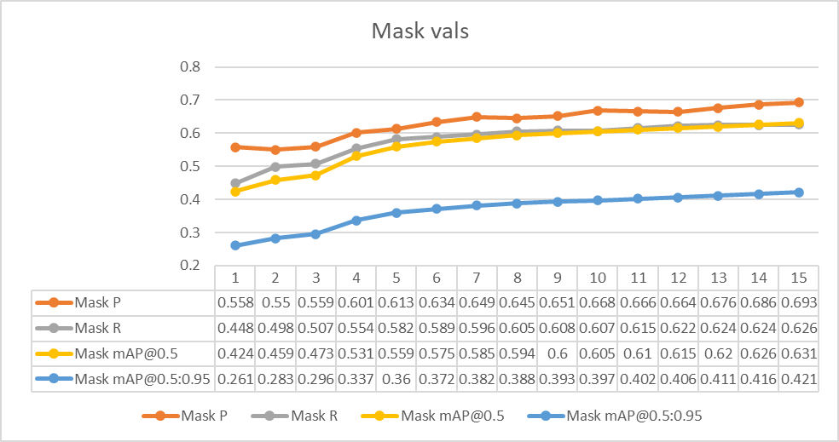
DL Model – Validation Metrics
3. Results & Performance
Notes:
Detection (Box) Metrics
Header Meaning Impact Improvement Tips
Box(P)
Precision of bounding box predictions (TP / (TP + FP)).
Higher = fewer false positives.
Tweak confidence threshold, use better post-processing (e.g., NMS), reduce label noise.
Box(R)
Recall of box predictions (TP / (TP + FN)).
Higher = fewer missed detections.
Increase object coverage with augmentations, reduce occlusion, improve class balance.
mAP50
Mean Average Precision at IoU=0.5.
General indicator of detection performance.
Widely used metric. Boost with improved training data and longer training.
mAP50-95
mAP averaged over IoU thresholds from 0.5 to 0.95.
Stricter, more precise metric than mAP50.Improves with better localization and generalization.
Prioritize for production-quality models.

Slide 29
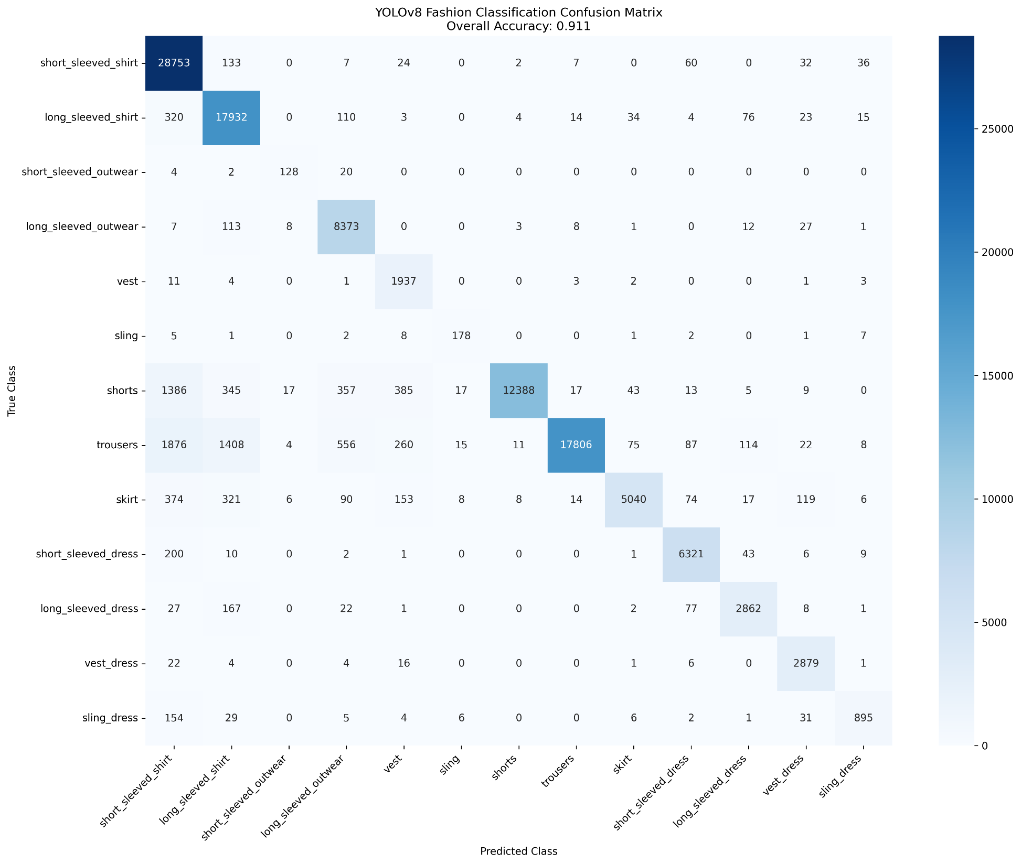
DL Model – Confusion Matrix
Accuracy≈91%
3. Results & Performance

Slide 30
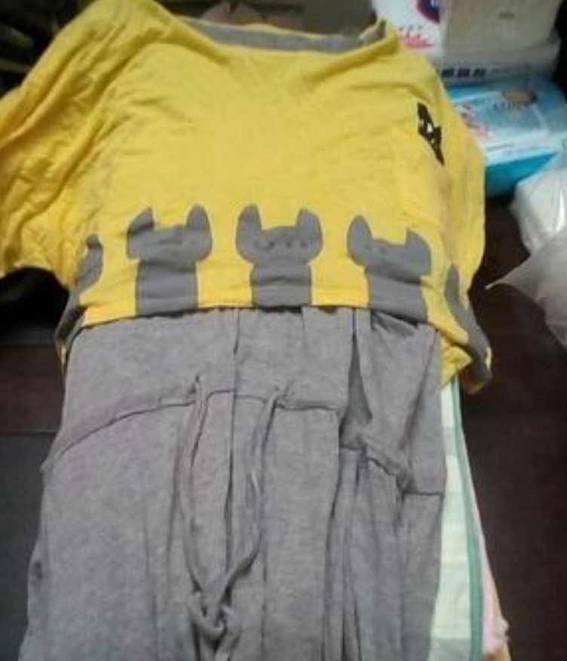
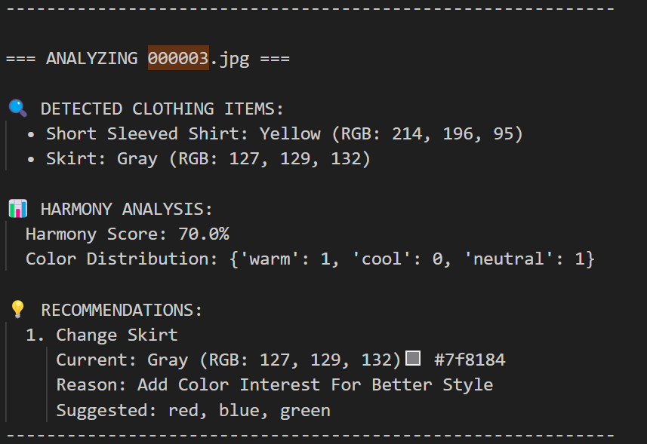
Some examples of the final output
3. Results & Performance
Notes:
1. Ultra-Strict Scoring System:
Single neutral items: 35% max (was 100%)
All neutral outfits: -50% penalty (massive)
All dark outfits: -30% penalty
All washed out: -30% penalty
No actual colors: -40% penalty
2. New Issue Categories:
completely_monotone_boring
mostly_neutral_lacks_interest
all_dark_depressing
all_washed_out
no_actual_colors
no_focal_point
outfit_needs_color_interest
3. Score Compression:
Scores above 80% compressed to max 70%
Scores above 60% compressed to 40-55%
Most outfits will score 20-50%
4. Realistic Expectations:
All gray/black outfits: 25-35%
Navy + white: 60-65%
Mixed warm/cool: 20-35%
Perfect classic combinations: 65-70% max

Slide 31
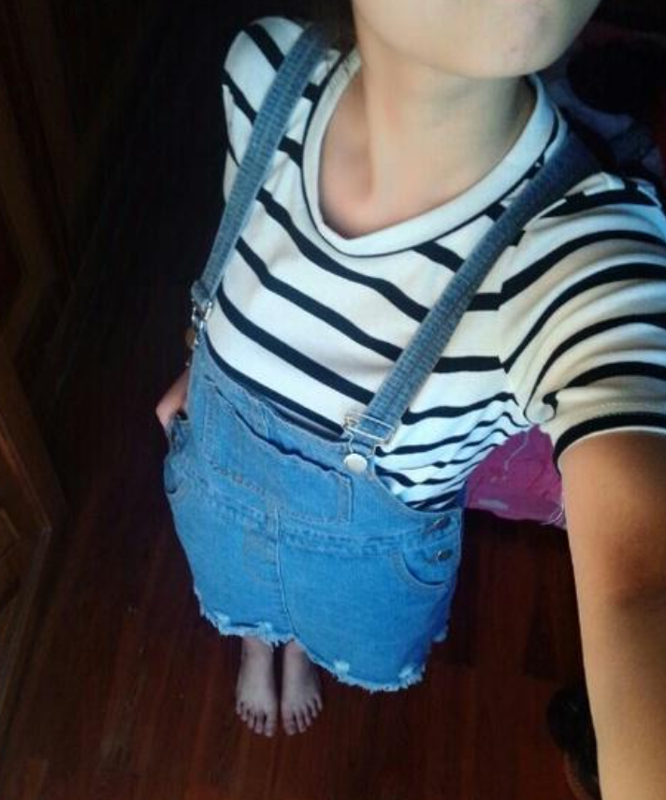
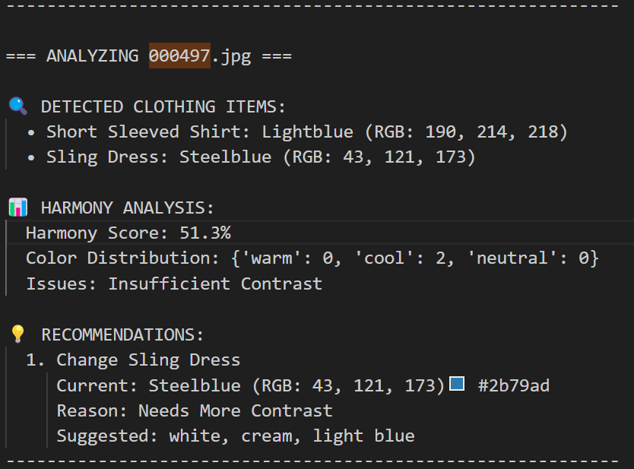
Some examples of the final output
3. Results & Performance

Slide 32
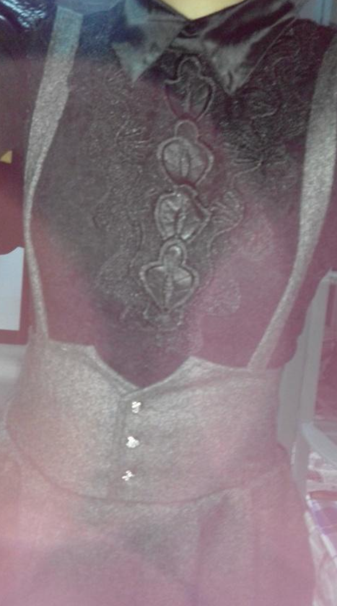
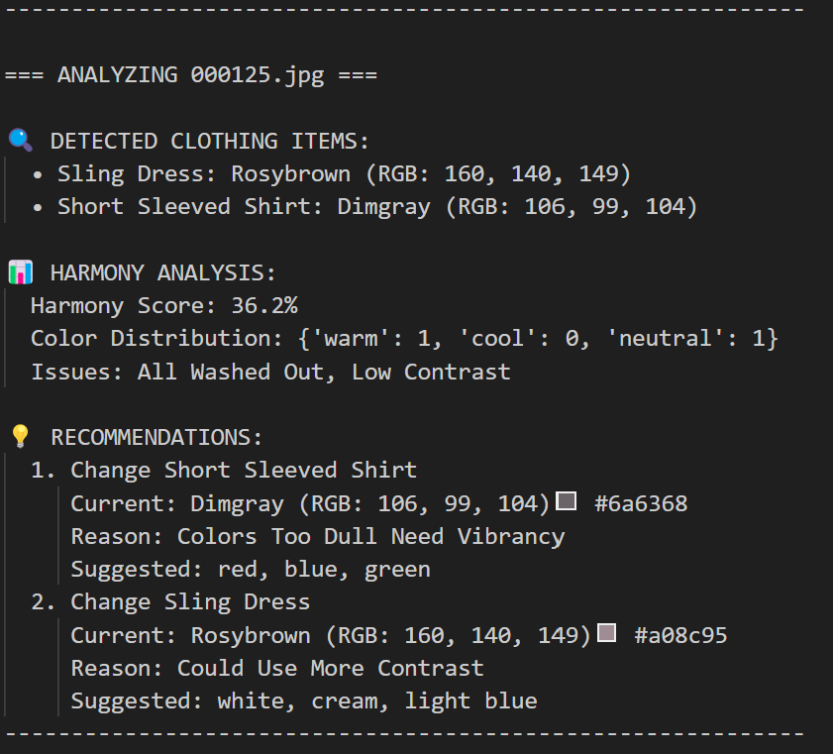
Some examples of the final output
3. Results & Performance

Slide 33

Learnings
Challenges
Knowledge applied
Future Improvements

Slide 34
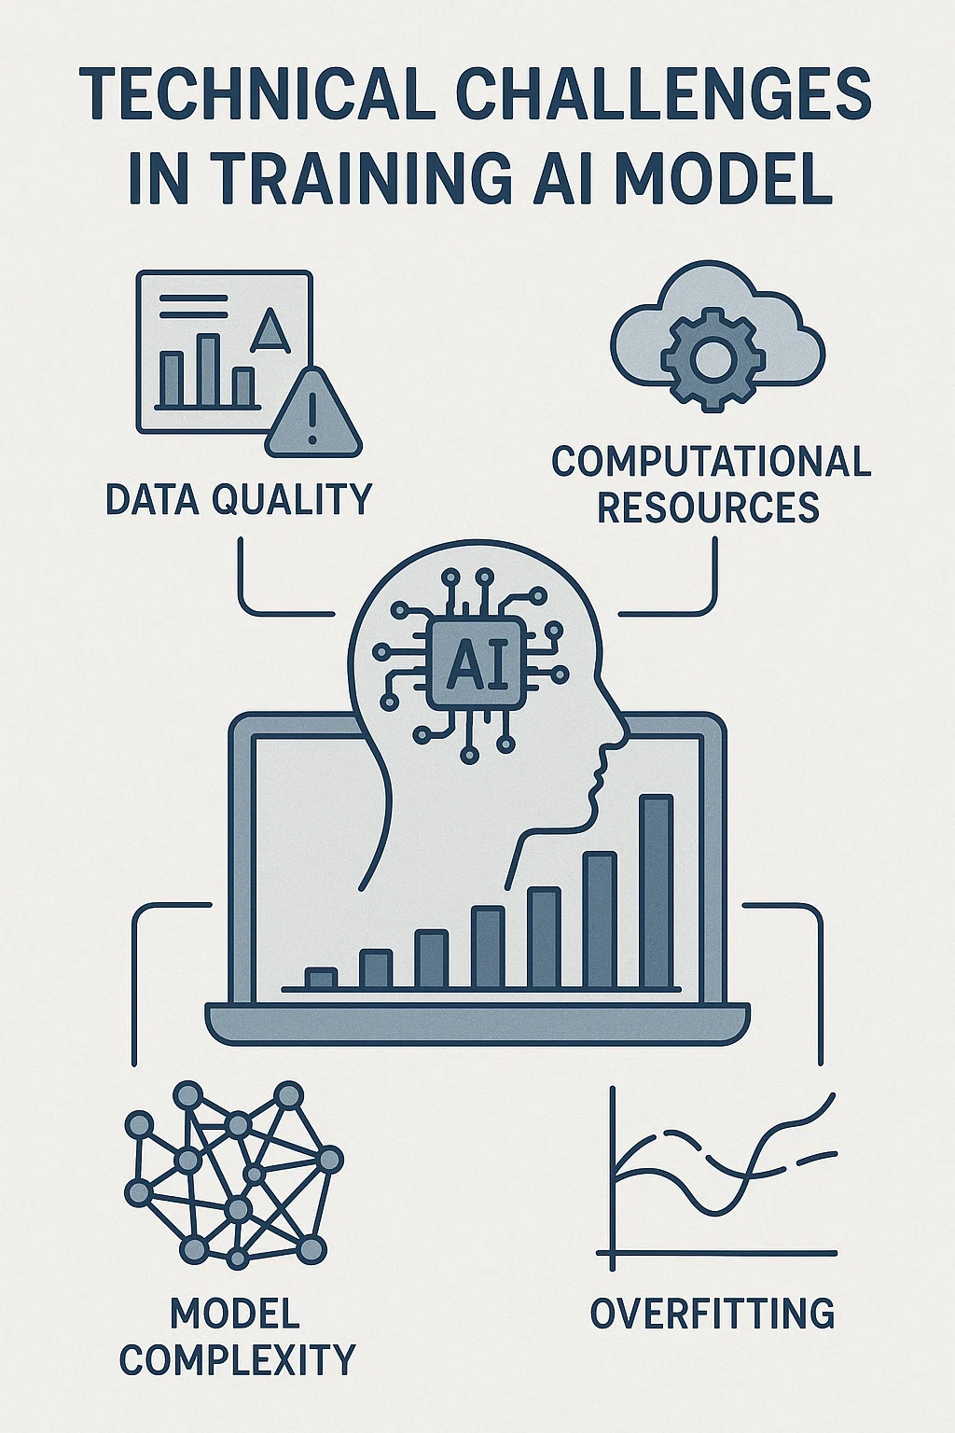
Technical Challenges
Challenges Encountered
Dataset Conversion: DeepFashion2 → YOLO format complexity
Memory Optimization: 8GB VRAM limitations with large models
Real-time Performance: Balancing accuracy vs. speed
Color Space Selection: RGB vs. HSV for clustering
Solutions Implemented
Custom conversion script handling DeepFashion2's unique annotation format
Batch size optimization and mixed precision training
Model size tuning (medium vs. large) for optimal performance
RGB color space for perceptually meaningful clustering while HSV for recommendations
4. Learnings

Slide 35
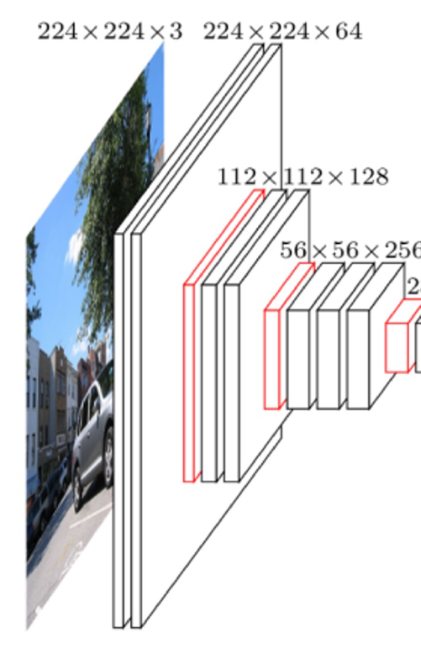
Course concepts applied
Deep Learning Fundamentals (Lecture 01)
Supervised Learning: YOLOv8 training on labeled fashion data
Unsupervised Learning: K-means color clustering
Multi-task Learning: Simultaneous detection + segmentation
CNN Architecture (Lecture 02)
Convolutional Layers: Feature extraction from fashion images
Transfer Learning: Pre-trained YOLOv8 → Fashion domain
Real-world Application: Computer vision for fashion analysis
Regression & Classification (Lecture 03)
Bounding Box Regression: Precise clothing localization
Multi-class Classification: 13 clothing categories
Evaluation Metrics: mAP, precision, recall for model assessment
4. Learnings
Notes:
Deep Learning Fundamentals (Lecture 01)
Supervised Learning: YOLOv8 training on labeled fashion data
Definition: Supervised learning uses labeled data—images with known outputs (e.g., bounding boxes, masks, and class labels)—to train a model to map inputs to outputs21115.
How it works in your project: Each clothing image is annotated with the correct class (e.g., “skirt”), bounding box, and segmentation mask. The model learns to predict these outputs for new, unseen images.
Theory: The model minimizes a loss function (e.g., cross-entropy for classification, regression loss for bounding boxes) using optimization algorithms like SGD. The goal is to generalize from training data to real-world data215.
Course link: This is the core paradigm for most computer vision tasks, as introduced in Lecture 01.
Unsupervised Learning: K-means color clustering
Definition: Unsupervised learning finds patterns in data without labels. Clustering algorithms like K-means group similar data points together based on feature similarity3.
How it works in your project: After segmentation, pixel colors within each clothing item are clustered (e.g., in HSV space) to find dominant colors—no color labels needed.
Theory: K-means minimizes within-cluster variance, assigning each pixel to the nearest centroid. This reveals the natural color structure of each clothing region3.
Course link: This is a classic unsupervised learning technique, as discussed in Lecture 01 and 04.
Multi-task Learning: Simultaneous detection + segmentation
Definition: Multi-task learning (MTL) trains a model to perform several related tasks at once, sharing representations to improve generalization4.
How it works in your project: YOLOv8 is trained to both detect (bounding box, class) and segment (pixel mask) clothing items in a single pass.
Theory: Hard parameter sharing in MTL reduces overfitting and leverages shared features for better performance on each task4.
Course link: MTL is a modern deep learning strategy, highlighted for its efficiency and improved generalization in Lecture 01 and in recent research4.
CNN Architecture (Lecture 02)
Convolutional Layers: Feature extraction from fashion images
Definition: Convolutional layers apply learned filters to input images, extracting spatial features like edges, textures, and patterns57.
How it works in your project: YOLOv8’s backbone (e.g., CSPDarknet) uses stacks of convolutional layers to extract hierarchical features from clothing images.
Theory: Early layers capture low-level features; deeper layers capture complex shapes and object parts, enabling robust recognition57.
Course link: CNNs are the foundation of modern computer vision, covered in depth in Lecture 02.
Transfer Learning: Pre-trained YOLOv8 → Fashion domain
Definition: Transfer learning adapts a model trained on a large source dataset (e.g., COCO) to a new target dataset (e.g., DeepFashion2) with limited data6.
How it works in your project: YOLOv8 is fine-tuned on your fashion dataset, leveraging prior knowledge of visual features to speed up learning and improve accuracy.
Theory: Freezing early layers preserves generic features; only task-specific layers are retrained for the new domain6.
Course link: Transfer learning is a practical strategy for efficient model adaptation, as discussed in Lecture 02.
Real-world Application: Computer vision for fashion analysis
How it works in your project: The trained model is used for automated clothing recognition, color analysis, and style recommendations—mirroring real-world AI applications in retail and e-commerce7.
Course link: Demonstrates the translation of deep learning theory into impactful, real-world solutions.
Regression & Classification (Lecture 03)
Bounding Box Regression: Precise clothing localization
Definition: Regression predicts continuous values. In object detection, bounding box regression predicts the coordinates (x, y, width, height) of each object’s location in the image812.
How it works in your project: YOLOv8 regresses bounding box coordinates for each detected clothing item.
Theory: The regression head minimizes a loss function (e.g., mean squared error) between predicted and true box coordinates812.
Course link: Bounding box regression is a key example of regression in deep learning, as covered in Lecture 03.
Multi-class Classification: 13 clothing categories
Definition: Multi-class classification assigns each input (e.g., image region) to one of three or more classes (e.g., “skirt”, “vest”, etc.)913.
How it works in your project: The model predicts one of 13 fashion classes for each detected item.
Theory: The classification head uses softmax activation and cross-entropy loss to train on labeled categories913.
Course link: Multi-class classification is a fundamental supervised learning task, as discussed in Lecture 03.
Evaluation Metrics: mAP, precision, recall for model assessment
Definition:
mAP (mean Average Precision): Measures detection accuracy across all classes and IoU thresholds1014.
Precision: Fraction of correct positive predictions among all positive predictions.
Recall: Fraction of correct positive predictions among all actual positives.
How it works in your project: Used to assess how well the model detects and segments clothing items, and to compare model versions.
Theory: These metrics balance false positives/negatives and provide a comprehensive view of model performance1014.
Course link: Model evaluation and selection is a core topic in Lecture 03.

Slide 36
Future Enhancements & Applications
Potential Improvements
Real-world Applications
Texture Analysis: Incorporate fabric patterns and textures
Trendiness Recommendations: Instagram trend-appropriate color suggestions
Personal Style Learning: User preference adaptation
3D Pose Integration: Body shape and fit, skin color considerations
E-commerce Styling: Automated outfit recommendations
Fashion Retail: Inventory color harmony analysis
Personal Wardrobe: Mobile app for daily outfit coordination
Fashion Education: Teaching color theory through AI
4. Learnings

Slide 37

Closing

Slide 38



Conclusion & Key Takeaways
Project Achievements | Technical Skills Demonstrated | Course Learning Applied
Successfully implemented end-to-end fashion analysis pipeline | Deep Learning: YOLOv8 training and optimization | Applied supervised learning for clothing
Combined multiple DL paradigms (supervised + unsupervised) | Computer Vision: Object detection and segmentation | Utilized unsupervised learning for color analysis
Achieved real-time performance on consumer hardware | Data Engineering: Large dataset preprocessing and conversion | Implemented CNN architectures for computer vision tasks
Practical application of course concepts to real-world problem | Color Science: HSV analysis and fashion color theory integration | Demonstrated practical ML project development skills
5. Closing

Slide 39

THANK YOU! Questions?

